Slide 1
FOOD DELIVERY TIME ANALYSIS
BY: HAILIN

Slide 2
WHY I CHOSE THIS?
-Food delivery is used a lot in everyday life
-Delivery time directly affects customer satisfaction
-I wanted to understand what factors cause delays
-Focused on distance and traffic because they are common factors

Slide 3
DATA OVERVIEW
Data Description:
-Includes distance, traffic level, delivery time
-Also includes weather, vehicle type, and time of day
-Used to analyze what affects delivery performance
SOURCE:https://www.kaggle.com/datasets/denkuznetz/food-delivery-time-prediction

Slide 4
RESEARCH QUESTIONS
-Does traffic level change how distance affects delivery time?
-How much additional delivery time is caused by traffic compared to distance?

Slide 5
TOOLS USED
-Pandas : data handling
-Seaborn : visualization
-Sklearn : linear regression

Slide 6
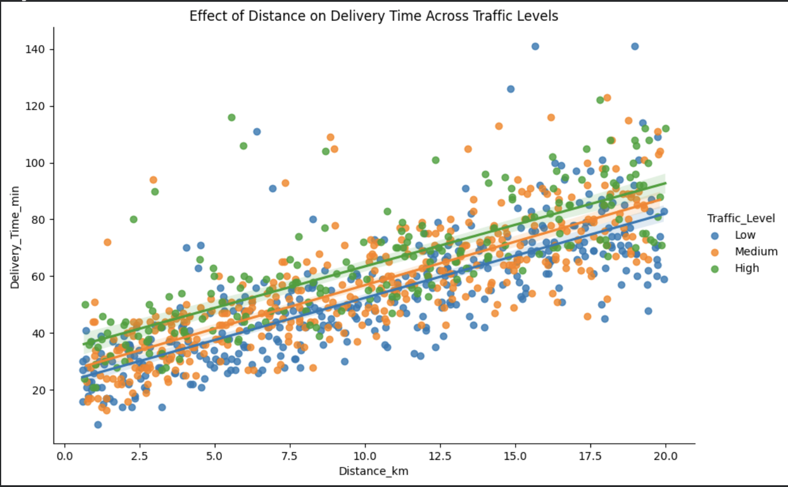
DISTANCE VS DELIVERY
-Delivery time increases with distance
-Higher traffic points are higher overall
-Traffic increases delivery time at same distance

Slide 7
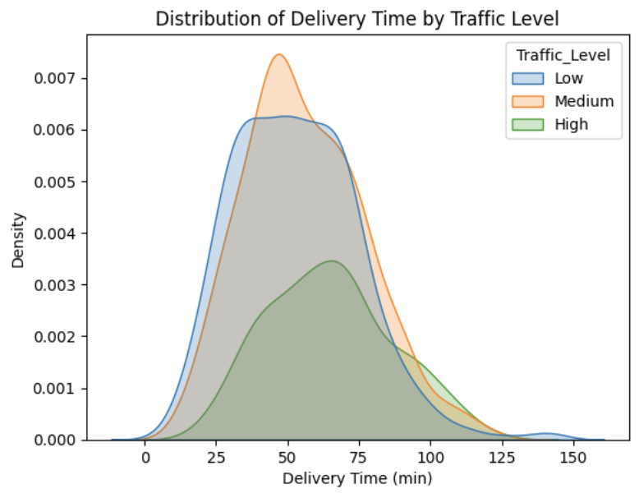
DISTRIBUTION BY TRAFFIC
-Shows distribution of delivery time
-Higher traffic shifts values to the right
-High traffic has longer delivery times overall

Slide 8
REGRESSION ANALYSIS
-Linear regression was used
-Distance has a strong positive effect
-Traffic adds additional delay
-Both variables predict delivery time

Slide 9
CONCLUSION
-Distance and traffic both impact delivery time
-Traffic increases delays beyond distance alone
-Understanding this can improve delivery efficiency

